Slide 1

Course No: CSE 2188 Course Title: Software Engineering Sessional
“Heaven’s light is our guide”
RAJSHAHI UNIVERSITY OF ENGINEERING & TECHNOLOGY
DEPARTMENT OF MECHATRONICS ENGNEERING
26-Feb-2020

Slide 2
Team Members:
NAME ROLL NO
Azim Miah 1808028
Bishowjit Paul 1808029
A. K. M. Mohibur Rahman 1808030
Abu Bakar Siddik 1808031
Enamul Hasan Shahed 1808032
Page 02

Slide 3
Our Software:
PATHFINDING VISUALIZER
26-Feb-2020

Slide 4
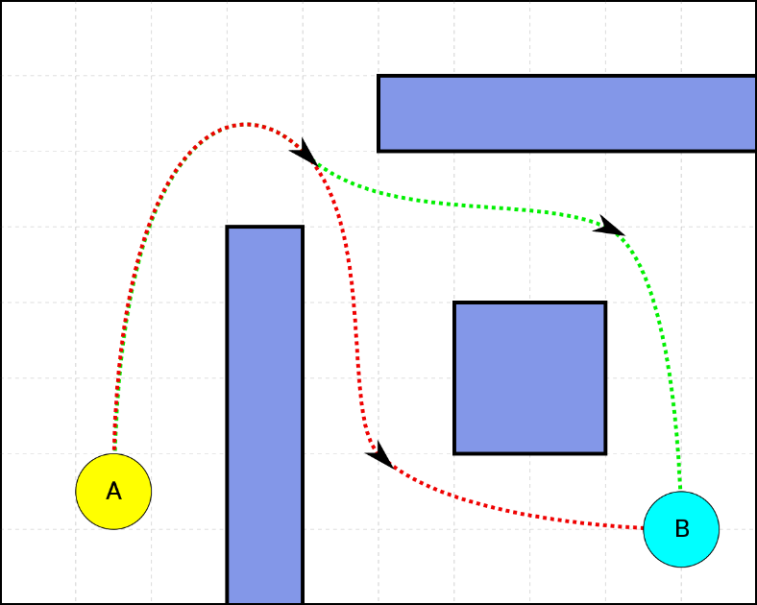
WHAT IS PATHFINDING VISUALIZER?
Process of discovering the shortest path through obstacles between two points.
Page 04

Slide 5
What are we using for developing this software?
Page 05

Slide 6
LET’S SEE WHAT TKINTER is!!!
Tkinter is the standard GUI library for Python.
Tkinter provides a powerful object-oriented interface to the Tk GUI toolkit.
Page 06

Slide 7
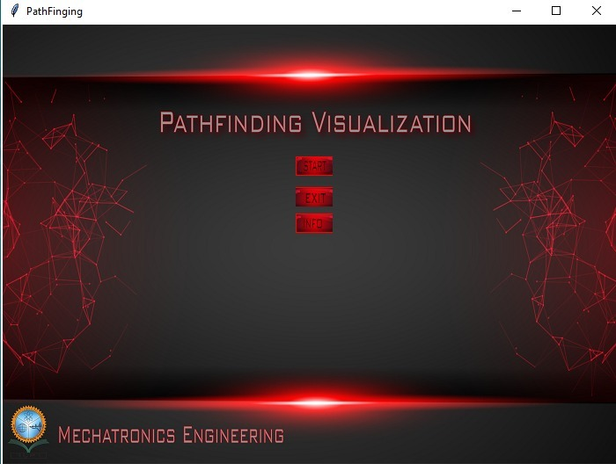
PROGRESS
Page 07

Slide 8
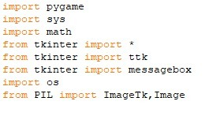
Pygame is a cross-platform set of Python modules designed for writing video games. It includes computer graphics and sound libraries designed to be used with the Python programming language.
Page 08

Slide 9

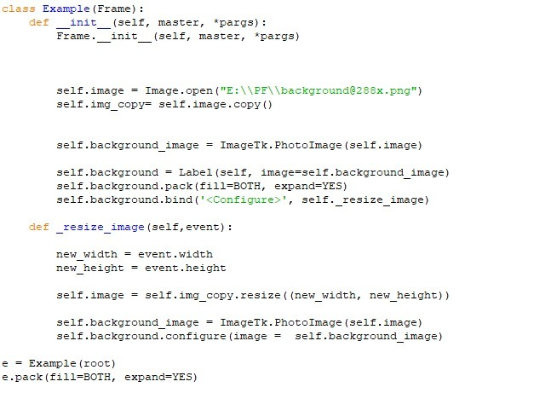
LAYOUT ANALYSIS
Page 09

Slide 10

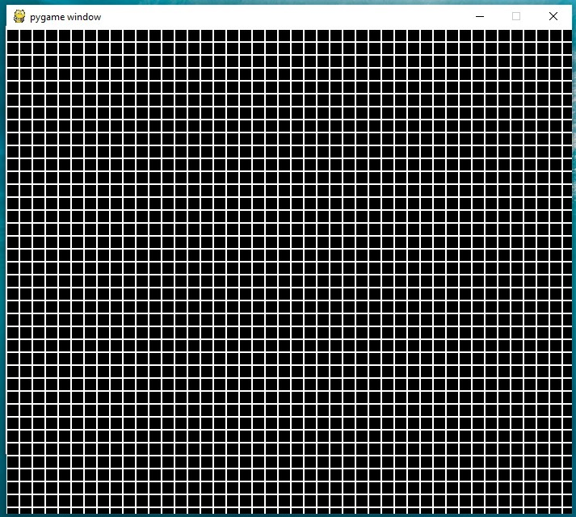
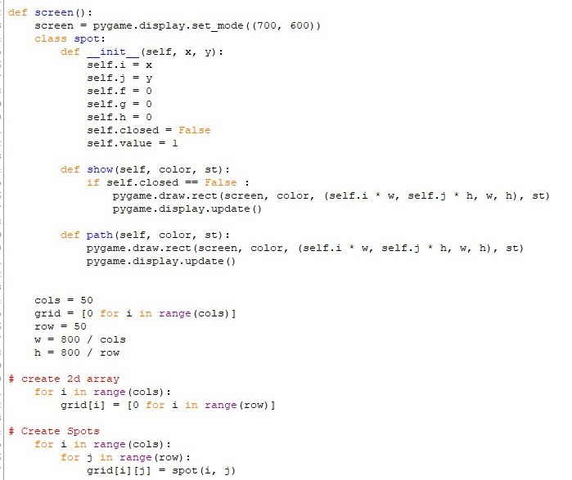
START BUTTON
BUTTONS
Page 10

Slide 11

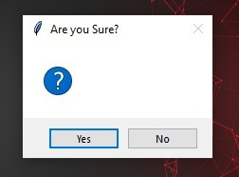

EXIT BUTTON
Page 11
26-Feb-2020

Slide 12


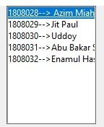
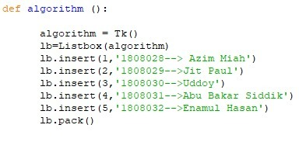
Info BUTTON
Page 12
26-Feb-2020

Slide 13
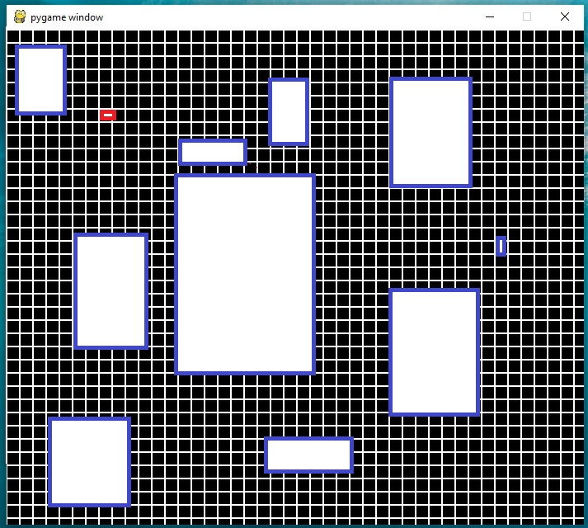
Next Target
Page 13
CSE 2188 (Software Engineering Sessional)
26-Feb-2020

Slide 14
THANK YOU!!!
Page 14
CSE 2188 (Software Engineering Sessional)
26-Feb-2020

